Slide 1
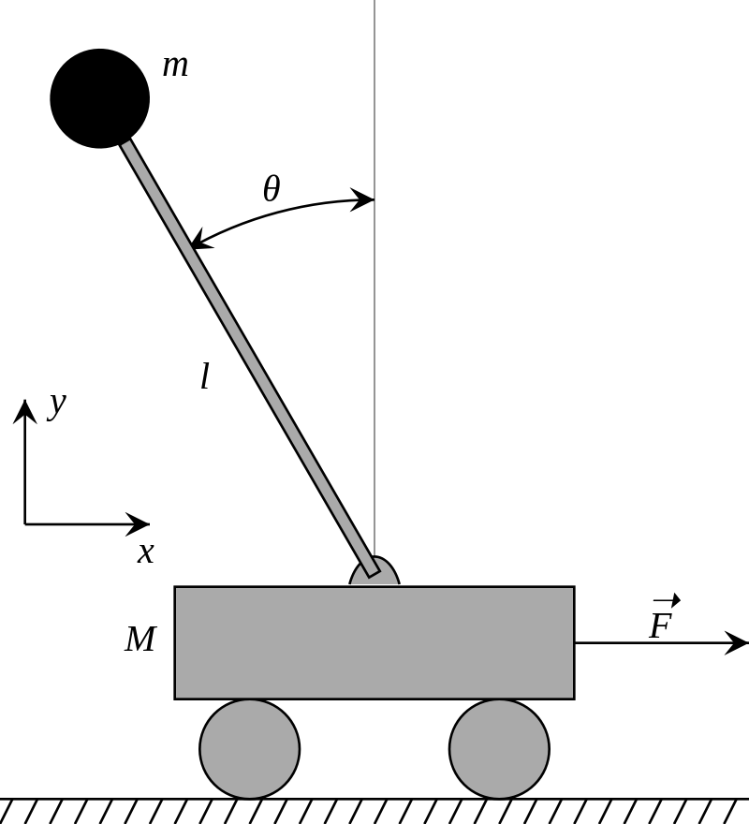
A reinforcement learning approach applied to inverted pendulum control
Source: wikipedia.org, no copyright

Slide 2
Reinforcement Learning?
Differs from both supervised and unsupervised learning
Involves an agent, an environment, actions, states and rewards
The environment gives us a state and a reward for every action taken by the agent
A policy is a mapping of states to actions
The goal is to construct an Agent which optimizes a policy to maximize the total reward received
Agent
Benefits to this approach:
Very generic
We don’t need to know much about the environment
We don’t need to know any policy
State,
Reward
Action
Environment

Slide 3
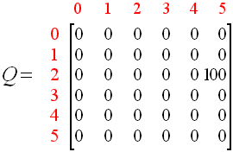
Q-Learning Algorithm
Introduced by Watkins, C.J.C.H. (1989), Learning from Delayed Rewards
The goal of the agent is to maximize its total reward, not just instant rewards
It does this by considering the expected maximum reward attainable from future states, in addition to the current state
But how do we know what to expect? We need a Q (Quality) function
One way is to build a Q-Table, first initialized randomly (or to 0) and update as the agent probes the environment
Stores rewards for discovered state and action pairs, we can use to discover the action with the highest reward
The table is updated according to a specific rule, discussed soon
Observe the current state, s.
Choose an action, a, for that state based on one of the action selection policies (or randomly)
Take the action, and observe the reward, r, as well as the new state, s'.
Update the Q-value for the state using the observed reward and the maximum reward possible for the next state.
Set the state to the new state, and repeat the process until a terminal state is reached.
An early iteration of a Q-Table:
Pseudocode:
Action
Initialize the Q-values table, Q(s, a). For each episode (epoch):
State

Slide 4
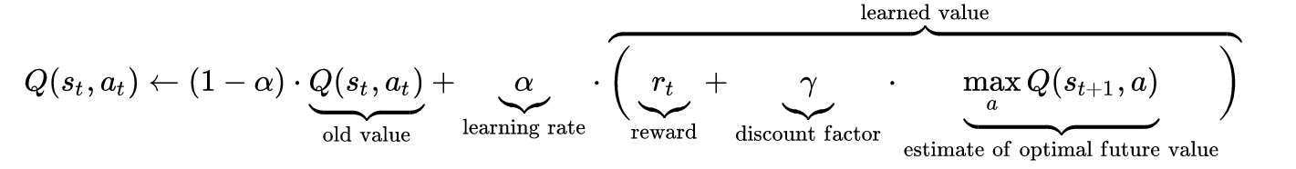
Q-Learning Algorithm
α is the learning rate (0 < α ≤1) - α is the extent to which our Q-values are being updated in every iteration.
γ is the discount factor (0 ≤ γ ≤ 1) - how much importance do we want to give to future rewards? A high value captures the long-term effective award, whereas a discount factor of 0 makes our agent consider only immediate reward (greedy)
t is the discrete time step
r_{t} is the reward returned for the action a_{t} performed at state s_{t} which moves us into state s_{t+1}
Estimate of optimal future value: find the highest reward possible in the action space of next state
Action
State

Slide 5
Q-Learning Algorithm
Discovery vs Exploitation
We can introduce another parameter, epsilon, to control how much we want our agent to value exploration as opposed to exploitation of known policies
0 < ε ≤ 1 before performing the action proposed by the Q-Table, we can generate a random number of the same range of ε. If the random number is greater than epsilon, we will disregard the action chosen and instead chose a random action
Action
State

Slide 6
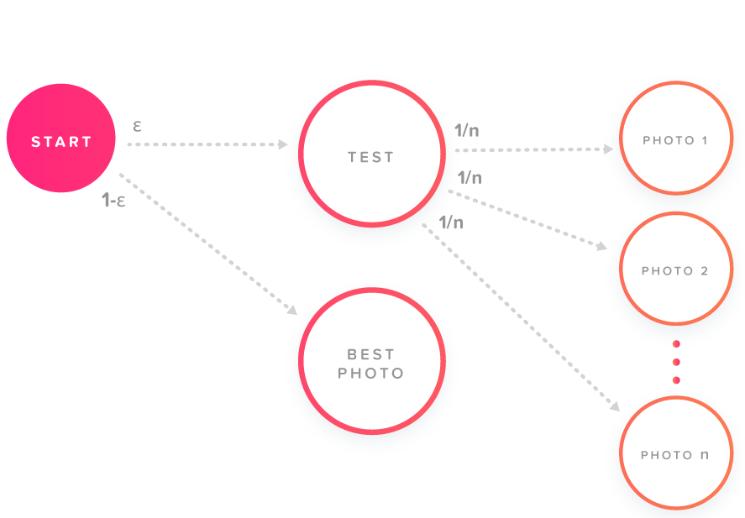
Q-Learning Algorithm
Epsilon allows us to parameterize the precedence of discovery vs exploitation
Source: tinder.com

Slide 7
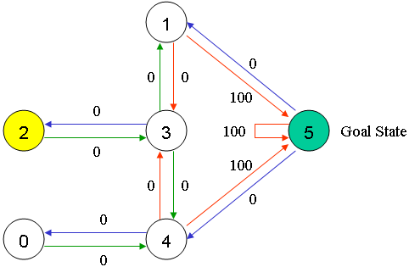
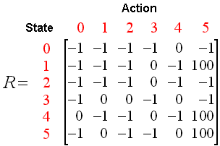
Q-Table Learning in a simple example
Implementation: q-learn-graph.py
Environmental Reward - (Unknown to agent)

Slide 8
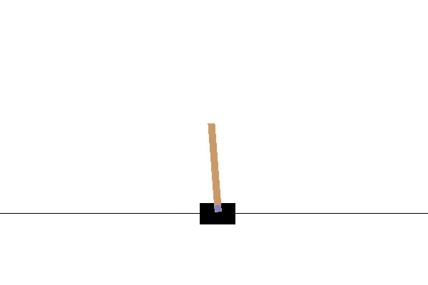
The Inverted Pendulum - OpenAI Gym

Slide 9
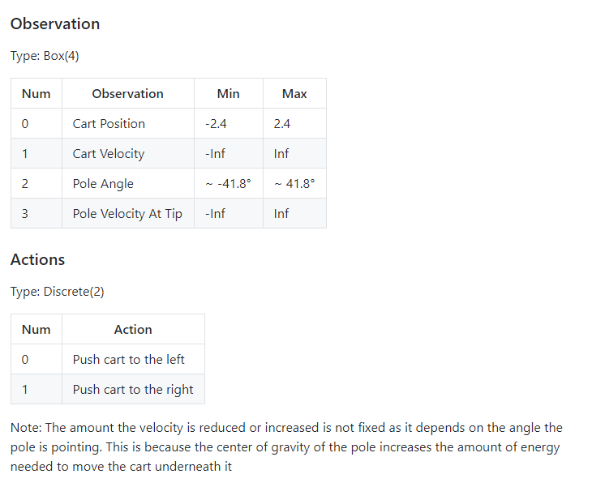
Cartpole
In every time step t, the agent: - Gets an observation (x, x’, theta, theta’) corresponding to cart position, cart velocity, pole angle with the vertical, pole angular velocity - Performs an action LEFT or RIGHT, and receives a reward of +1 for having survived another time step, and a new state - The episode ends if the pole is more than 15 degrees from vertical and/or the cart is moving more than 2.4 units from center. - The task is considered done if the agent achieved and averaged reward of 200 over the last 50 episodes

Slide 10
So let’s use a Q-Table for cartpole?
That’s gonna get tricky fast:
Previous example, the state is 1 dimensional, and all state values are discrete
This is not only a higher (4) dimensional state, but the values are continuous (float)!
What can we do?
Discretize the state information, or
Approximate the Q function

Slide 11
Q Function Approximation with an Artificial Neural Network
Network architecture:
Input layer - 4 neurons (state’s observation values)
Hidden Layers - 2 x 24 neurons
Output layer - 2 neurons (Predicted reward of moving left -vs- reward of moving right)
Hyperparameters:
Learning rate = .05
Loss function = MSE
Activation function = ReLU
Batch size = 32 (for memory)

Slide 12
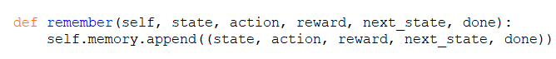
Further adaptations for the Agent:
Memory
Replay
Allow control of the neural network
Add a memory/replay module
Add epsilon decay module
Equip the agent with an array in which we can store environmental observations (state) as well as the action taken, the next state, whether this was the last step of the episode (done), and of course, the reward
The replay module does the following:
Assign to a mini_batch a sample of the tuples stored in self.memory
For each tuple in mini_batch:
If this step ended the game, assign to a variable target the reward
Else, assign to target the value: reward + gamma * maxarg(network.predict(next_state) )
Train the network with state as input, and target as the target value
Assign to the target not taken, the network predicted Q-value
We call the replay module at every training iteration, once the memory reaches our batch size

Slide 13
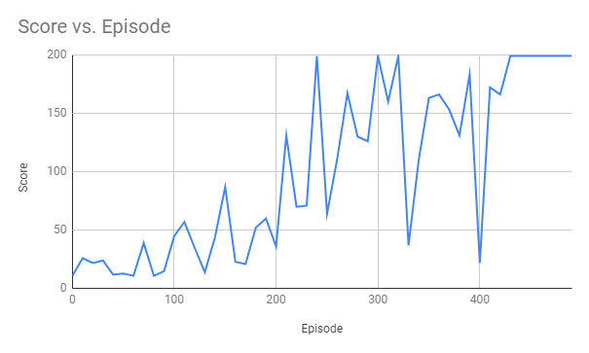
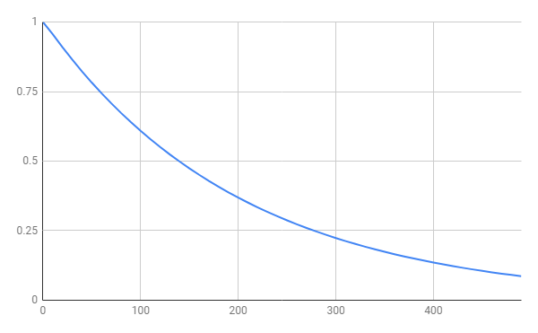
Sample / demonstration of results
Epsilon vs. Episode

Slide 14
What lies ahead:
Experiment with hyperparameters of the network, and of the agent in general:
Epsilon decay
alpha
gamma
- Adapt to a different game, i.e., pong
Convolutional NN in order to use raw pixel data

